Slide 1
Cloud Computing

Slide 2
Cloud Computing
Cloud computing has been a star since it was born; it appears with big data, Internet of Things (IoT), and Artificial Intelligence(AI) in our conversations.
Modern cloud computing services providers such as AWS, Microsoft Azure, and Google Cloud Platform, generally consist of four basic components: compute, network, database, and storage
advanced services support such as the ETL (extract, transform and load) processing and data analytics, Machine Learning (ML), AI, and also IoT services to communicate with IoTdevices

Slide 3
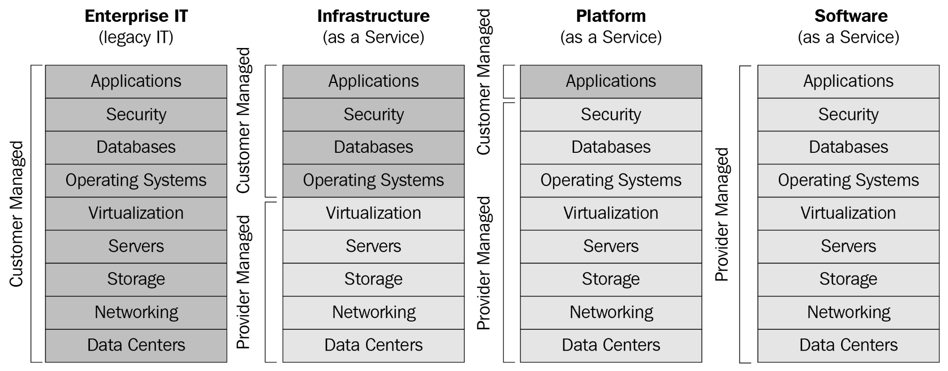
cloud computing service models
Notes:
IaaS – Infrastructure as a Service
As shown in the preceding screenshot, the IaaS service model provided is generally the capability of infrastructure level to the users; the cloud providers managed the hardware and infrastructure such as virtual servers, storage, networks, connectivity, operating systems and other fundamental computing resources. Based on the IaaS offering, users should manage them with administration works such as installing the patches, updates, and configurations. One of the best examples of this model is the virtual machine in the cloud.
PaaS – Platform as a Service
The PaaS services model provides the capability that comprises deployed and configured IT resources in a ready state based on the IaaS model. Users don't need to care about the infrastructure level and even the administration work they face when they're in the IaaS model. It directly provides the environment with the specified runtime. What users need to do is focus their work on the application level. An example of this is where Microsoft Azure provides a .NET / Node.js / PHP runtime in-app service,
SaaS – Software as a Service
Compared to PaaS, SaaS has a more advanced virtualization level, which is widely accessed over the internet and directly used by users. The most common example is Google's G Suite and Microsoft's Visual Studio Team Services (which is also known as Visual Studio Online or VSTS).
X as a Service in the cloud
Based on these models, there are also some extension concepts which are known as X as a service such as:
Database as a Service (DBaas): A managed database service in the cloud that aims to offer the database layer to the applications; the cloud provider manages the complex database environments.
Container as a Service (CaaS): A managed service model that provides the container-based virtualization technology to let users manage and deploy containers; and applications as well as container clusters in the cloud.
Messaging as a Service (MaaS): A messaging service in the cloud that allows sending and receiving messages through a queue. Originally implemented for the purpose of resolving queue-based load-leveling problems for a service whose peaks in demand make services or applications in the cloud overload and therefore unable to respond to requests in a timely manner. The queue acts as a buffer, storing the message until it’s retrieved by the service. Applications or services in the cloud retrieve the messages from the queue and process them.
Logic as a Service (LaaS): Also known as serverless. It gives little control over the infrastructure, the related infrastructure is managed by the cloud providers, and users can focus themselves on coding and configuring settings. Great examples include Azure Functions and Azure Logic Apps.
Identity as a service (IDaaS): Supplies cloud-based authentication or identity management to enterprises or organizations. The goal is to ensure if a user has access to cloud applications or services and which type of access they could have to cloud applications or services.
There are some other service models such as Disaster Recovery as a Service (DRaaS), Data as a Service (DaaS), Big Data as a Service (BDaaS), Log as a Service (LaaS), and more than the mentioned models here. We believe, as cloud computing is one of the fastest-growing technologies, more and more services will appear and may serve together for future cloud computing platforms.

Slide 4
Cloud deployment models
Four types of cloud deployment model:
Public cloud
Private cloud
Hybrid cloud
Community cloud

Slide 5
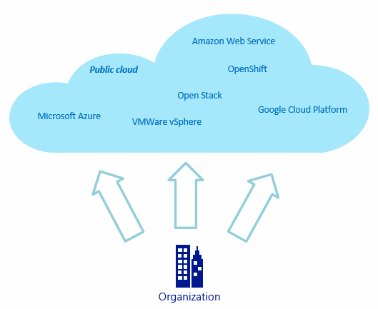
Public Cloud

Slide 6
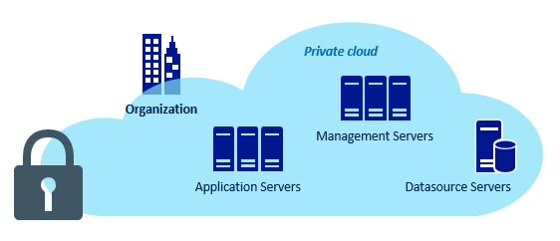
Private Cloud

Slide 7
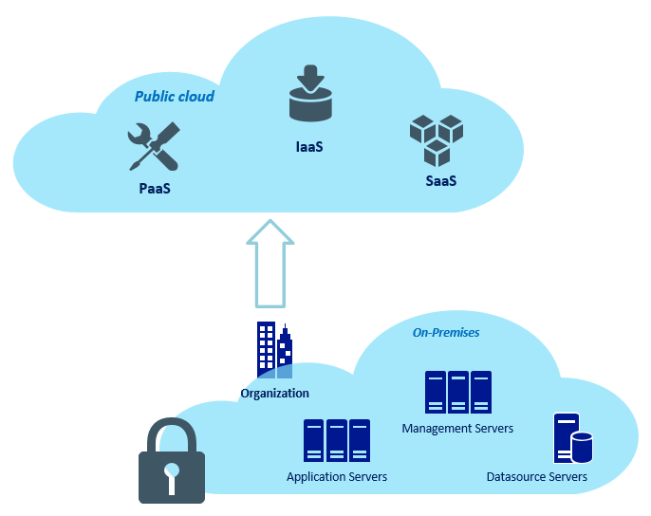
Hybrid Cloud

Slide 8
Why cloud computing?
Agility and scalability: Cloud provides a simple way to provide the underlying infrastructure for different types of applications. It’s easy to scale up and scale down, for its cloud capacity with high agility and scalability which is one of the greatest features that makes cloud computing different from the traditional way when we're working on-premise.
Cost-effective: Cloud computing provides IT resources in the cloud. It cuts down operational costs as compared to the traditional way. Most cloud providers allow pay as you go or another way to say it: pay for useas pricing solutions. Different sizes of business organizations will only pay for what they've consumed; it will cut down cost in a significant way when a cloud solution is applied to an organization, which is architecturally sound and cost-effective.
Disaster recovery: Cloud makes the deployment of identical IT resources and data replication in a simple way, and provides multiple ways to implement cloud-based or hybrid backup and recovery solutions across the region, which reduce the risk in case of disaster and facilitate a great way to minimize the downtime.
Global accessible: Cloud makes the deployment of the application in multiple regions around the world in an easy way. Users can access the public cloud from anywhere in the world once they've got an internet connection.

Slide 9
Considerations for implementing cloud-based infra services
Consider implementing with resilience: The cloud-native application is intended to be loosely coupled. This is the reason why the 12-factor app, which was first presented by Adam Wiggins in 2011, is becoming more and more popular while designing cloud-native applications..
Consider implementing with high availability: While implementing cloud-based infrastructure, always consider the availability of applications, replicating identical infrastructure in another data center, which is nearest and can provide higher availability rather than deploying to a single data center.
Consider implementing disaster recovery strategy: While implementing cloud-based infrastructure, you also need to consider the strategy to achieve your recovery time objective (RTO) and recovery point objective(RPO)..
Consider implementing the monitoring strategy: While implementing a cloud-based infrastructure, you also need to consider the strategy so that you can have a comprehensive vision of each resource to detect issues, problems, and take actions in a short time..

